Slide 1
Lec 2: Operations on Signals (Independent Variable )
Dr. Arsla Khan

Slide 2
Links for Video Lectures
1) Time Shifting
https://www.youtube.com/watch?v=9Cd5nVCFfc0
https://www.youtube.com/watch?v=3Qzpj6UUxhE&list=PLBlnK6fEyqRhG6s3jYIU48CqsT5cyiDTO&index=273
2) Time Scaling
https://www.youtube.com/watch?v=jnB-U5KBvN4&list=PLBlnK6fEyqRhG6s3jYIU48CqsT5cyiDTO&index=5
3) Time Reversal/Flipping/Folding
https://www.youtube.com/watch?v=BzAbZfT6RxQ&list=PLBlnK6fEyqRhG6s3jYIU48CqsT5cyiDTO&index=9

Slide 3
Operations on Signals
Operations with respect to x-axis (Time axis) / Transformations on the independent variable
Time Shifting
Time Reversal/Folding
Time Scaling
Operations with respect to y-axis (Amplitude) / Transformations on the dependent variable
Amplitude Multiplication
Amplitude Scaling
Addition
Subtraction

Slide 4

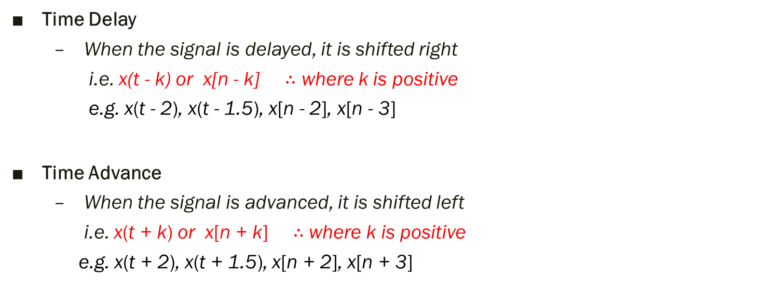

1) Time Shifting
Time Delay
When the signal is delayed, it is shifted right
i.e. x(t - k) or x[n - k] $∴$ where k is positive
e.g. x(t - 2), x(t - 1.5), x[n - 2], x[n - 3]
Time Advance
When the signal is advanced, it is shifted left
i.e. x(t + k) or x[n + k] $∴$where k is positive
e.g. x(t + 2), x(t + 1.5), x[n + 2], x[n + 3]
$$− ∞$$
$$+∞$$

Slide 5
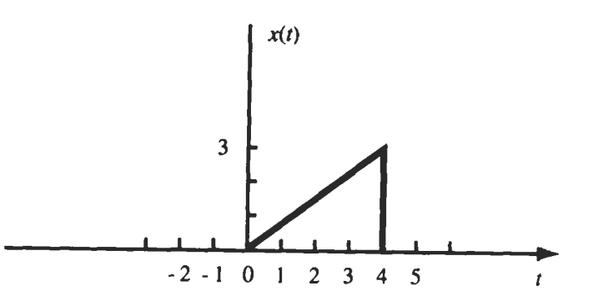
Exp 1.1: For x(t), sketch x(t - 2) and x(t + 2)

Slide 6
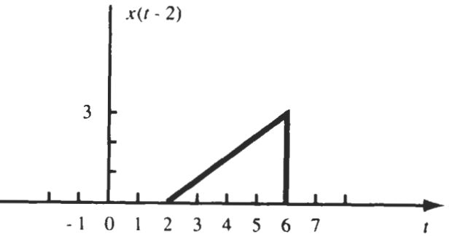


x(t - 2):
t – 2 = 0 → t = 0 + 2 = 2
t – 2 = 1 → t = 1 + 2 = 3
t – 2 = 2 → t = 2 + 2 = 4
t – 2 = 3 → t = 3 + 2 = 5
t – 2 = 4 → t = 4 + 2 = 6
$$t−2=0$$
$$t−2=1$$
Shifted towards right by 2 steps so it is a delayed signal

Slide 7
x(t + 2):
t + 2 = 0 → t = 0 + 2 = - 2
t + 2 = 1 → t = 1 - 2 = -1
t + 2 = 2 → t = 2 - 2 = 0
t + 2 = 3 → t = 3 - 2 = 1
t + 2 = 4 → t = 4 - 2 = 2

Slide 8
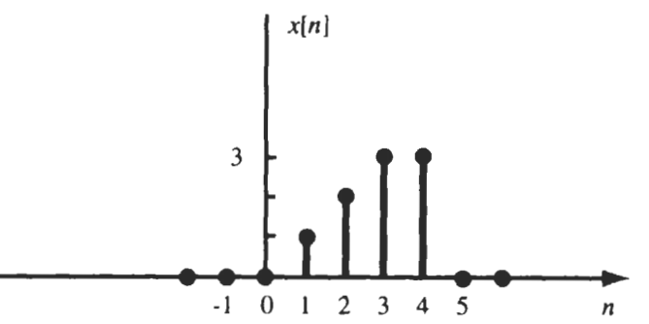
Exp 1.2: For x[n], sketch x[n - 2]

Slide 9
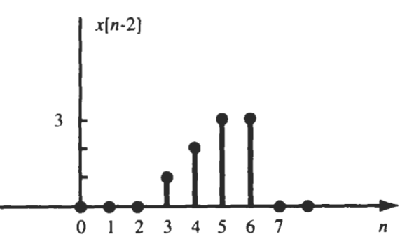
n – 2 = 0 → n = 2 – 0 = 2
n – 2 = 1 → n = 1 + 2 = 3
n – 2 = 2 → n = 2 + 2 = 4
n – 2 = 3 → n = 3 + 2 = 5
n – 2 = 4 → n = 4 + 2 = 6
Shifted towards right by 2 steps so it is a delayed signal

Slide 10
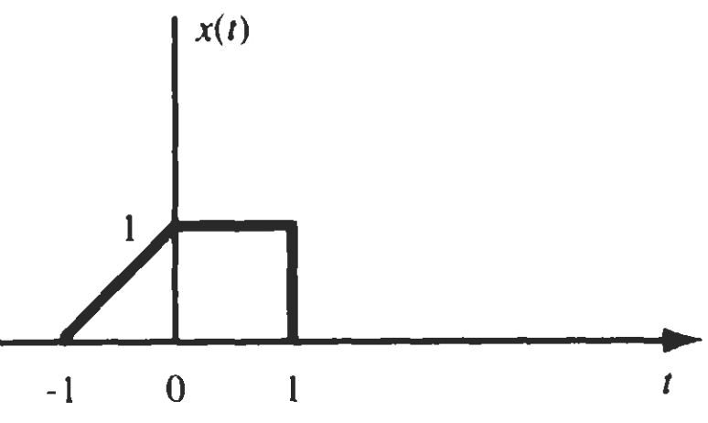
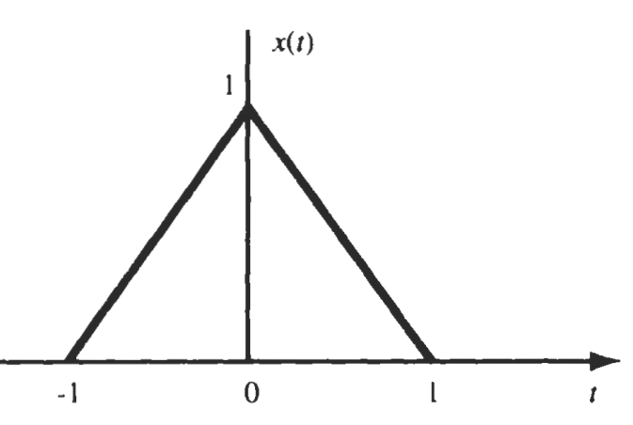
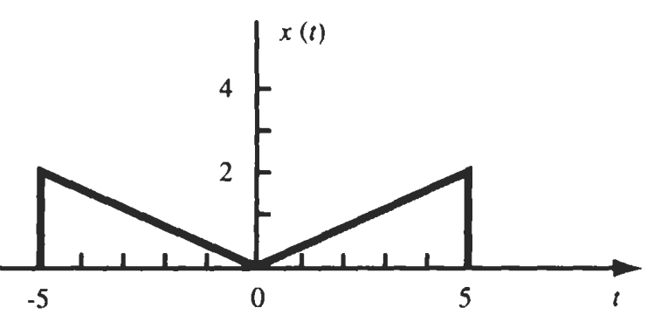
PP. 1.1) For signals given, sketch i) x(t – 2.5) ii) x(t + 1)
(b)
(c)
(a)

Slide 11
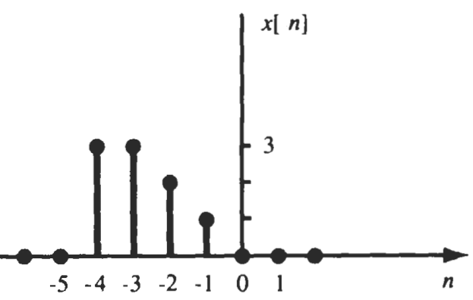
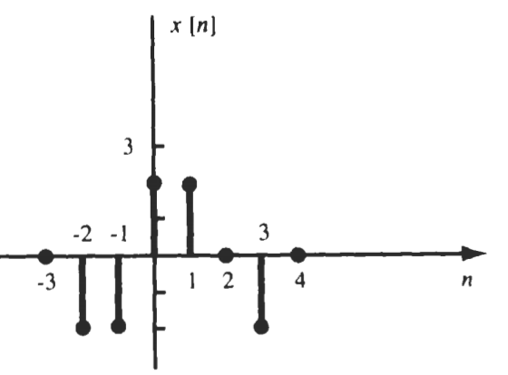
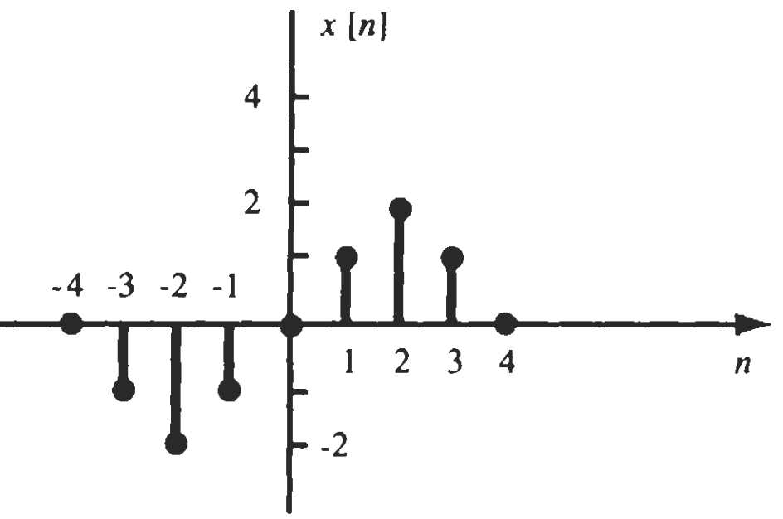
PP. 1.2) For signals given, sketch i) x[n-1] ii) x[n+3]
(a)
(b)
(c)

Slide 12
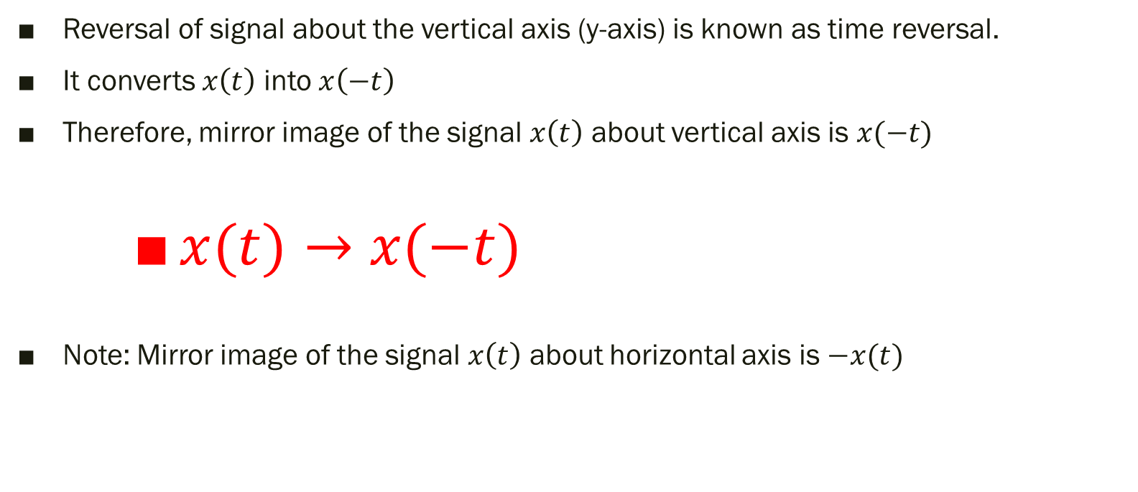
2) Time Reversal/Folding/Flipping
Reversal of signal about the vertical axis (y-axis) is known as time reversal.
It converts $x\left(t\right)$ into $x\left(−t\right)$
Therefore, mirror image of the signal $x\left(t\right)$ about vertical axis is $x(−t)$
$x(t)→$ $x(−t)$
Note: Mirror image of the signal $x\left(t\right)$ about horizontal axis is $−x(t)$

Slide 13
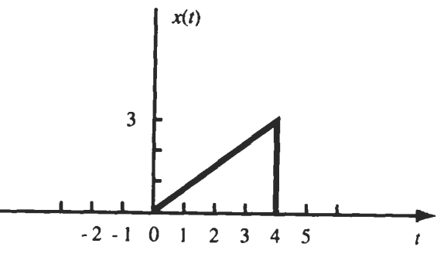
Exp 2.1: For x(t), sketch x(- t)

Slide 14
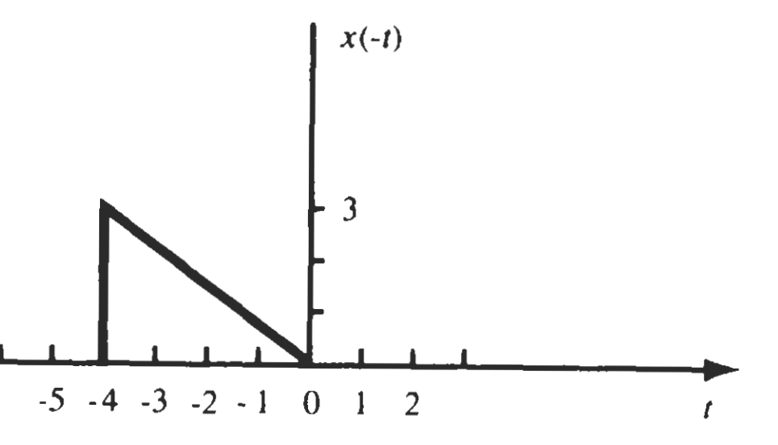

Points for transformed signal i.e. x(-t)
x(-t) = x(t)
$− t=0$ → $t=0$
$− t=$ 1 → $t=−1$
$− t=$ 2 → $t=−2$
$− t=$ 3 → $t=−3$
$− t=$ 4 → $t=−4$

Slide 15
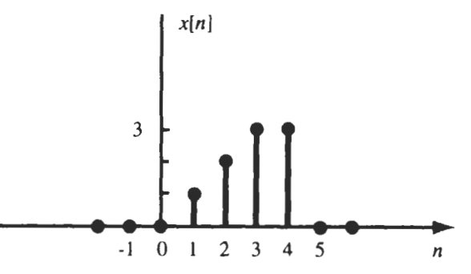
Exp 2.2: For x[n], sketch x[-n]

Slide 16
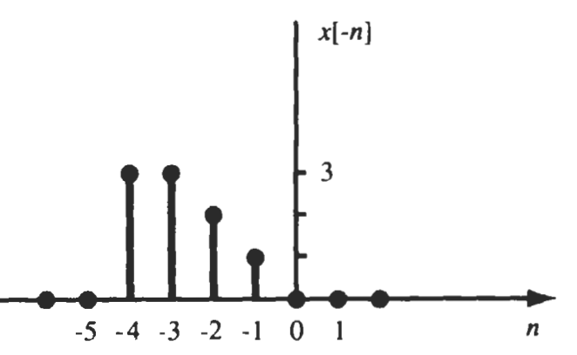

Slide 17

Difference between x(-t) and –x(t)
$x(t)$ → $x(−t)$ : Flipping around vertical axis (y-axis)
$x(t)$ → $−x(t)$ : Flipping around horizontal axis (x-axis)

Slide 18
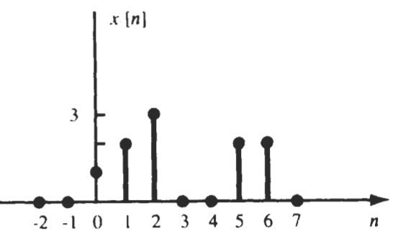
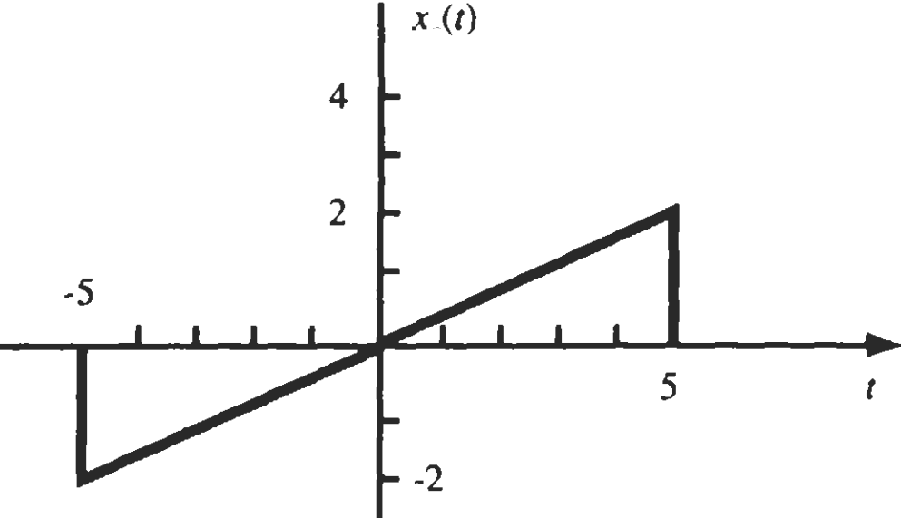
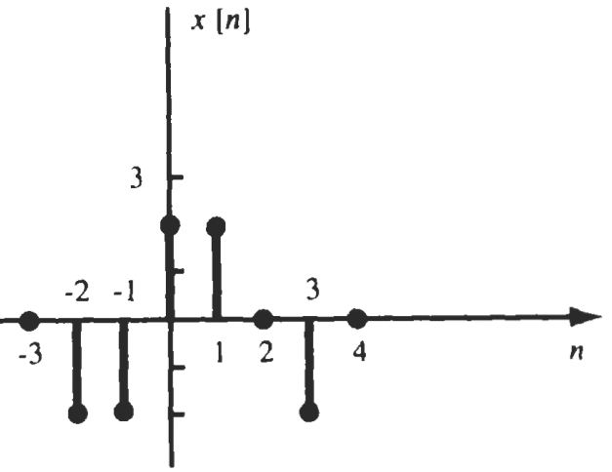
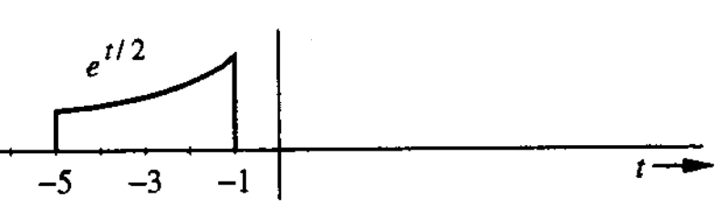
PP. 2.1) For signals given, sketch x(-t) and x[-n]
(c)
(a)
(d)
(b)

Slide 19
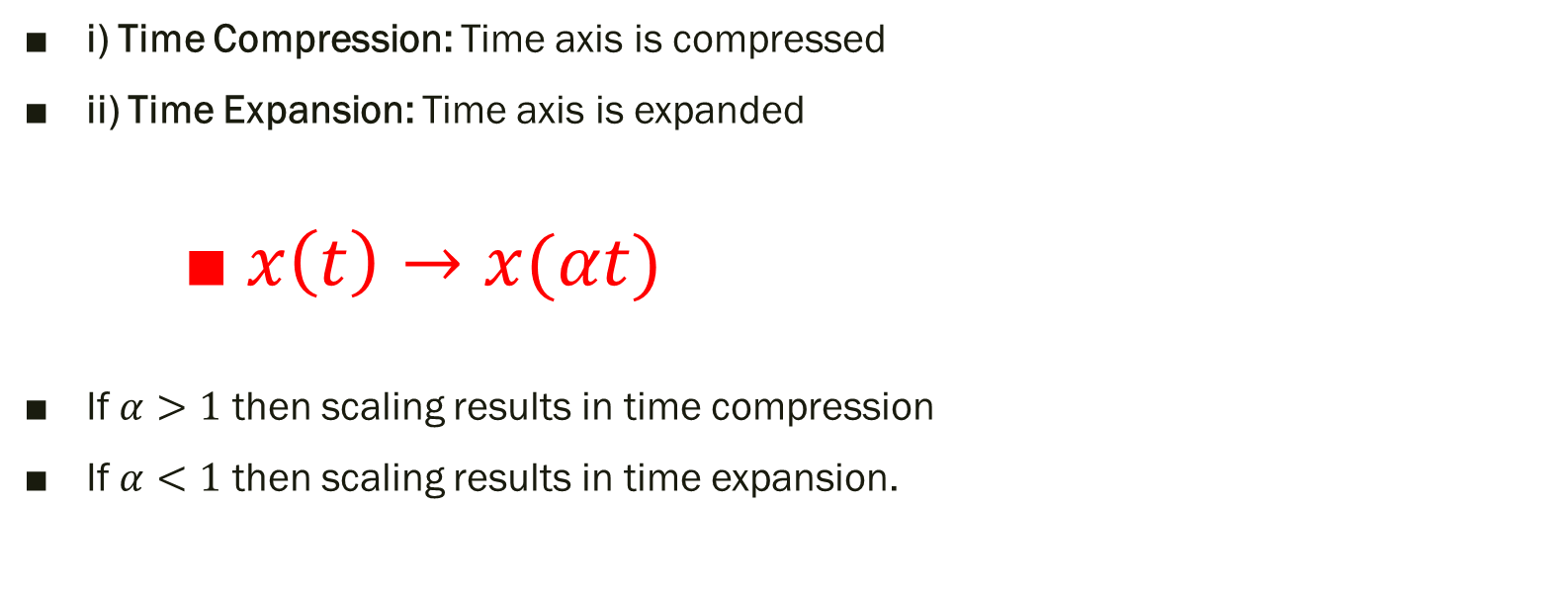
3) Time Scaling
i) Time Compression: Time axis is compressed
ii) Time Expansion: Time axis is expanded
$x\left(t\right)→x(αt)$
If $α>1$ then scaling results in time compression
If $α<1$ then scaling results in time expansion.

Slide 20
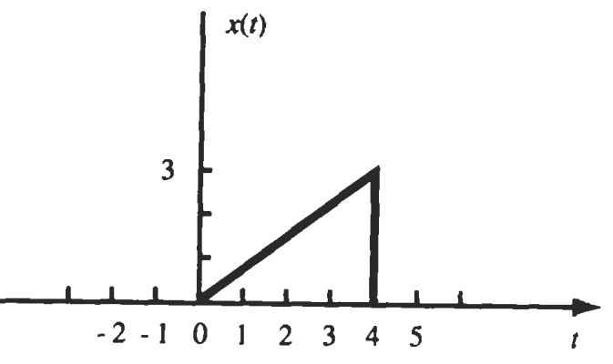
Exp 3.1: For the signal given, sketch x(2t) and x(t/2)

Slide 21
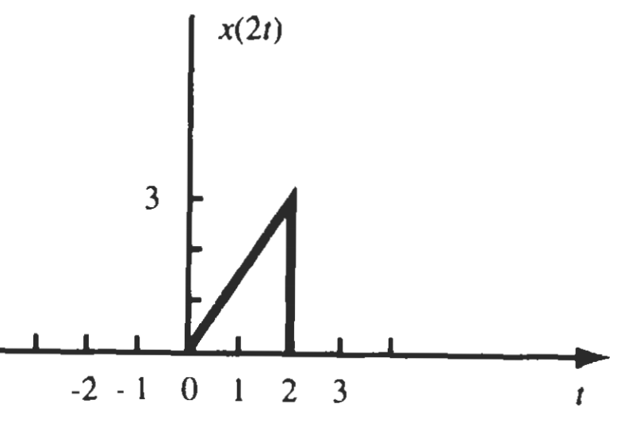
x(2t):
2t = 0 → t=0
2t = 1 → t=1/2=0.5
2t = 2 → t=2/2=1
2t = 3 → t=3/2=1.5
2t = 4 → t=4/2 = 2
Signal is compressed by 2 times

Slide 22
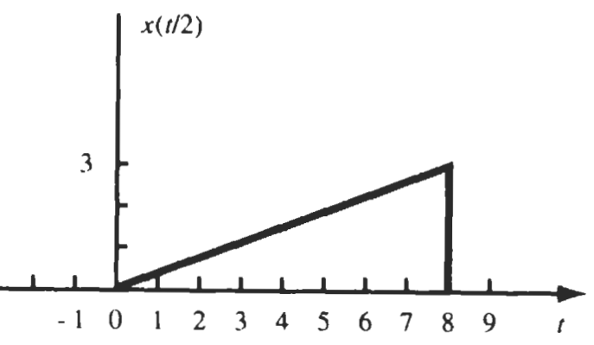
x(t/2):
t/2 = 0 → t=0
t/2 = 1 → t=2x1=2
t/2 = 2 → t=2x2=4
t/2 = 3 → t=2x3=6
t/2 = 4 → t=2x4=8

Slide 23
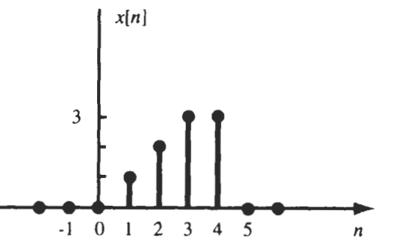
Exp 3.2: For the signal given, sketch x[2n] and x[n/2]

Slide 24
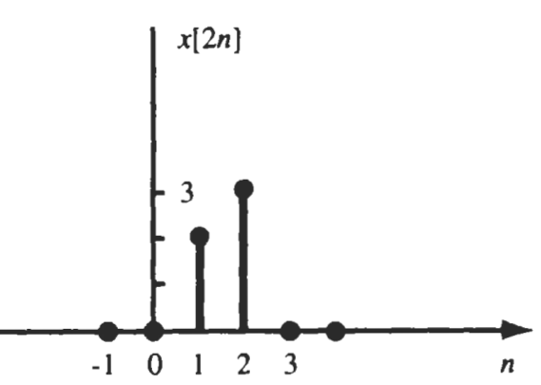






x[2n] → Down-sampling
2n = -2 → n=-1
2n = -1 → n=-1/5=-0.5
2n = 0 → n=0
2n = 1 → n=1/2=0.5
2n = 2 → n=2/2=1
2n = 3 → n=3/2=1.5
2n = 4 → n=4/2 = 2
Thus, for x[2n], pick every 2nd sample and discard other samples
Similarly for x[3n], pick every 3rd sample and discard other samples
$$\frac{−1}{2}$$
$$\frac{0}{2}$$
$$\frac{1}{2}$$
$$\frac{2}{2}$$
$$\frac{3}{2}$$
$$\frac{4}{2}$$

Slide 25
x[n/2] → Up-sampling
n/2 = -2 → n=-4
n/2 = -1 → n= -1 x 2= - 2
n/2 = 0 → n=0
n/2 = 1 → n=1 x 2= 2
n/2 = 2 → n=2 x2=4
n/2 = 3 → n=3 x 2=6
n/2 = 4 → n=4 x 2 = 8
Thus, x[n/2]→place samples at every 2nd place whereas zeros will be placed in between the samples
Thus, x[n/3]→place samples at every 3rd place whereas zeros will be placed in between the samples

Slide 26
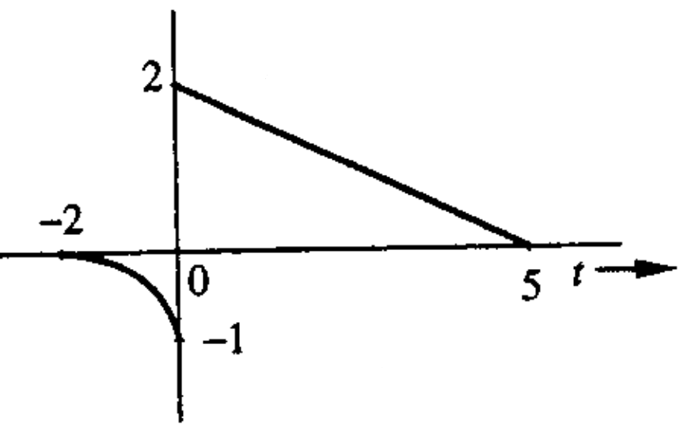
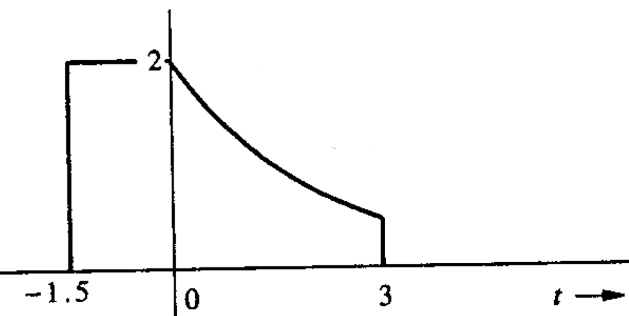
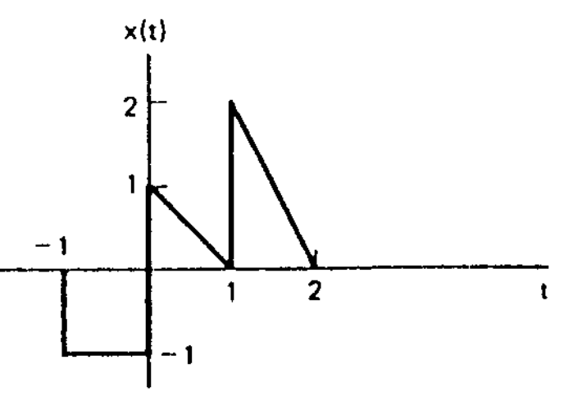
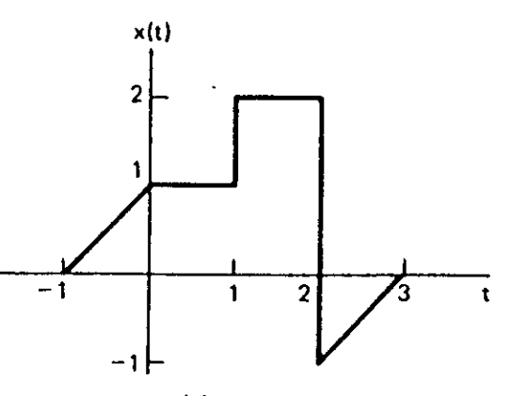
PP. 3.1) For signals given, sketch
(i) x(2t) (ii) x(t/3) (iii) x(1.5t)
(b)
(a)
(d)
(c)

Slide 27
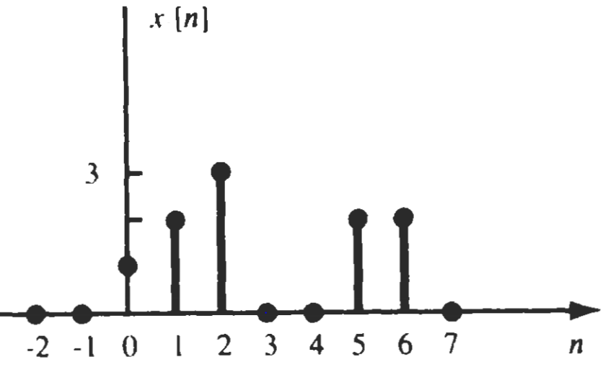
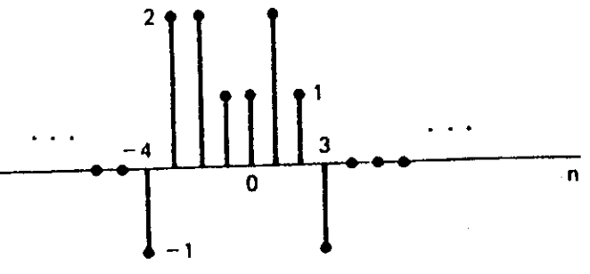
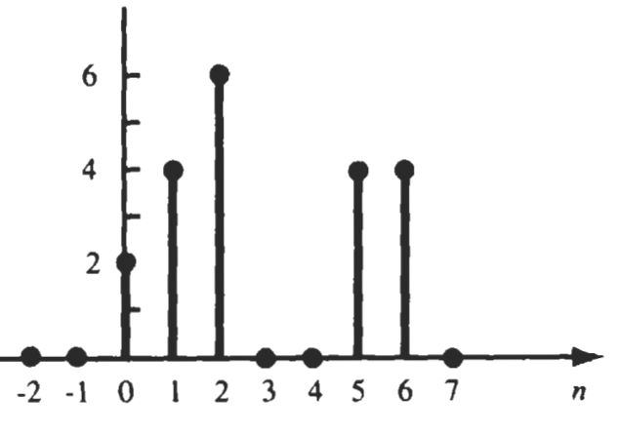
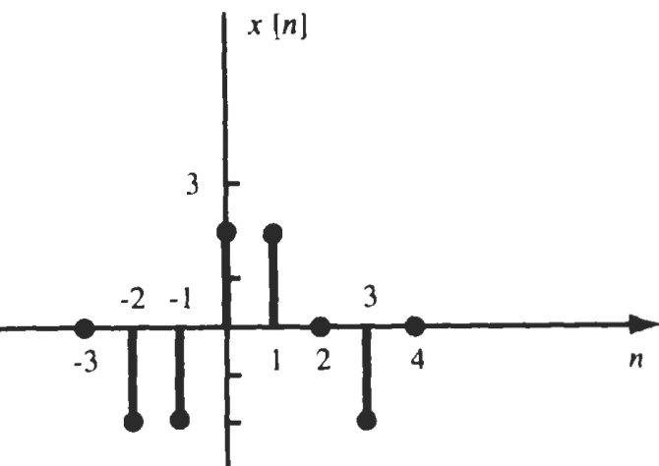
PP. 3.2) For signals given, sketch
(i) x[2n] (ii) x[3n] (iii) x[n/3]
(b)
(a)
(d)
(c)

Slide 28
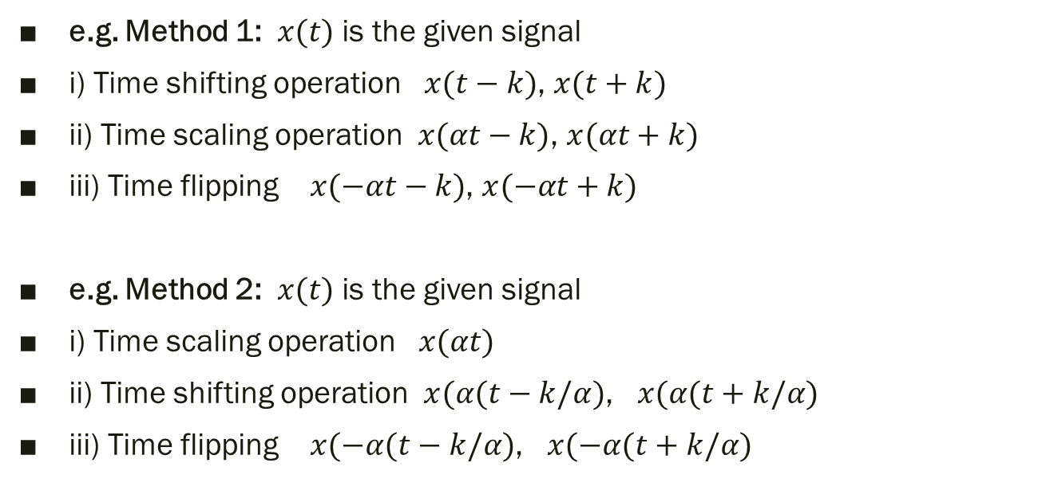
4. Precedence Rule for Combined Operations
There is no precedence rule. You can apply operations in any order
e.g. Method 1: $x(t)$ is the given signal
i) Time shifting operation $x(t−k)$, $x(t+k)$
ii) Time scaling operation $x(αt−k)$, $x(αt+k)$
iii) Time flipping $x(−αt−k)$, $x(−αt+k)$
e.g. Method 2: $x(t)$ is the given signal
i) Time scaling operation $x(αt)$
ii) Time shifting operation $x(α(t−k/α)$, $x(α(t+k/α)$
iii) Time flipping $x(−α(t−k/α)$, $x(−α(t+k/α)$

Slide 29
Exp 4.1: For the signal given, sketch x(-2t + 3)

Slide 30
x(t+3)
x(2t+3)
x(-2t+3)

Slide 31
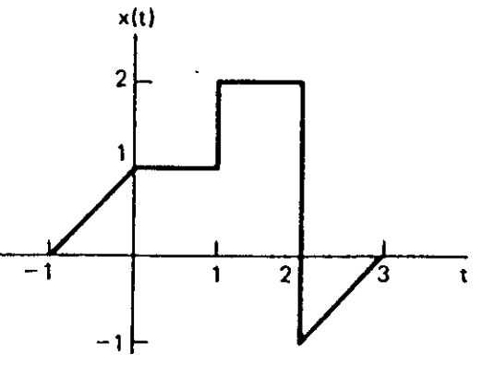
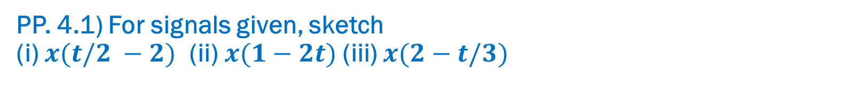
PP. 4.1) For signals given, sketch
(i) $x(t/2 −2)$ (ii)$x(1−2t)$ (iii) $x(2−t/3)$

Slide 32
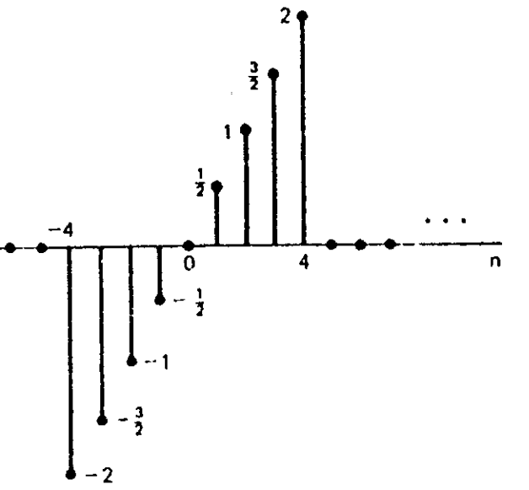
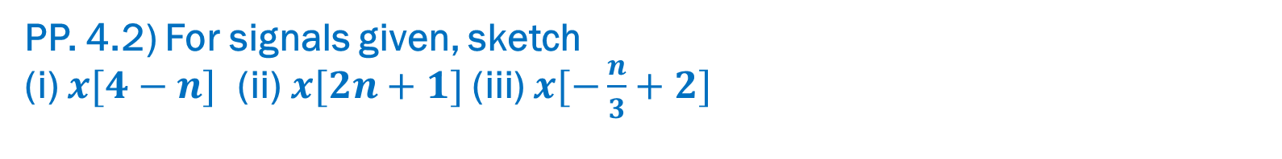
PP. 4.2) For signals given, sketch
(i) $x[4−n]$ (ii)$x[2n+1]$ (iii) $x[−\frac{n}{3}+2]$

Slide 33
Thank You !!!

